Slide 1


Python数据分析与机器学习
昆明理工大学计算中心

Slide 2

03
Matplotlib
3 数据绘图工具-Matplotlib

Slide 3
本讲提纲
01
Matplotlib介绍
02
折线图
03
散点图、柱状图
04
三维立体图
Notes:
本讲主要介绍文件的基本概念和类型、文件的打开和关闭方法、以及在Python中如何使用上下文管理器设置文件的使用范围。

Slide 4


Slide 5
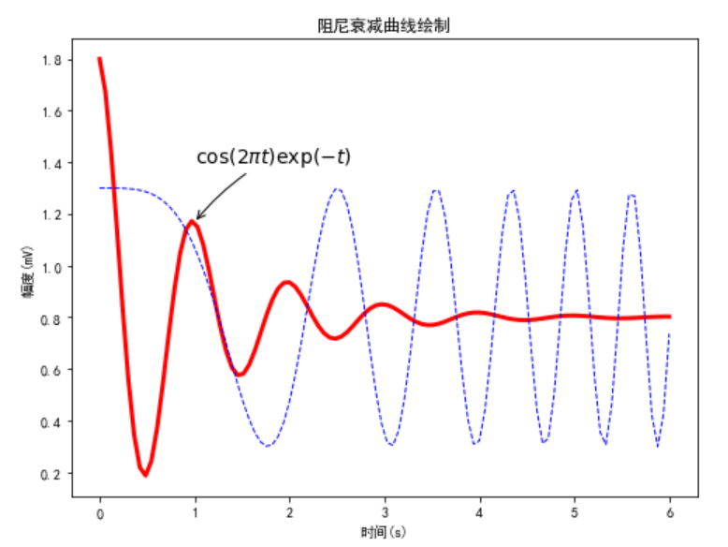
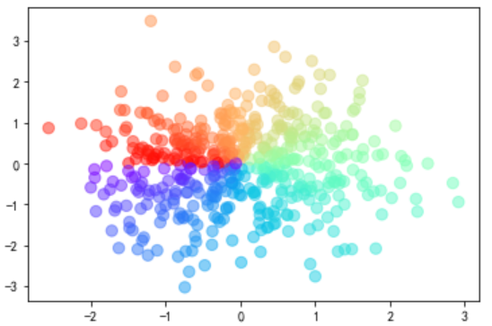
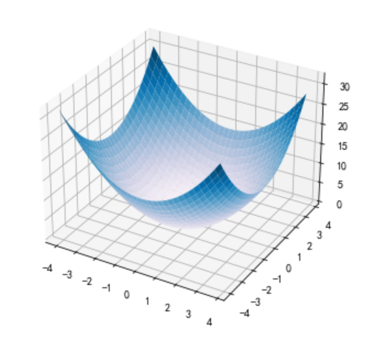
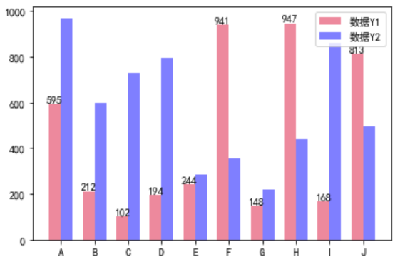

Slide 6
官网
http://matplotlib.org/
从官网examples入门学习
http://matplotlib.org/examples/index.html
https://matplotlib.org/stable/gallery/index.html

Slide 7
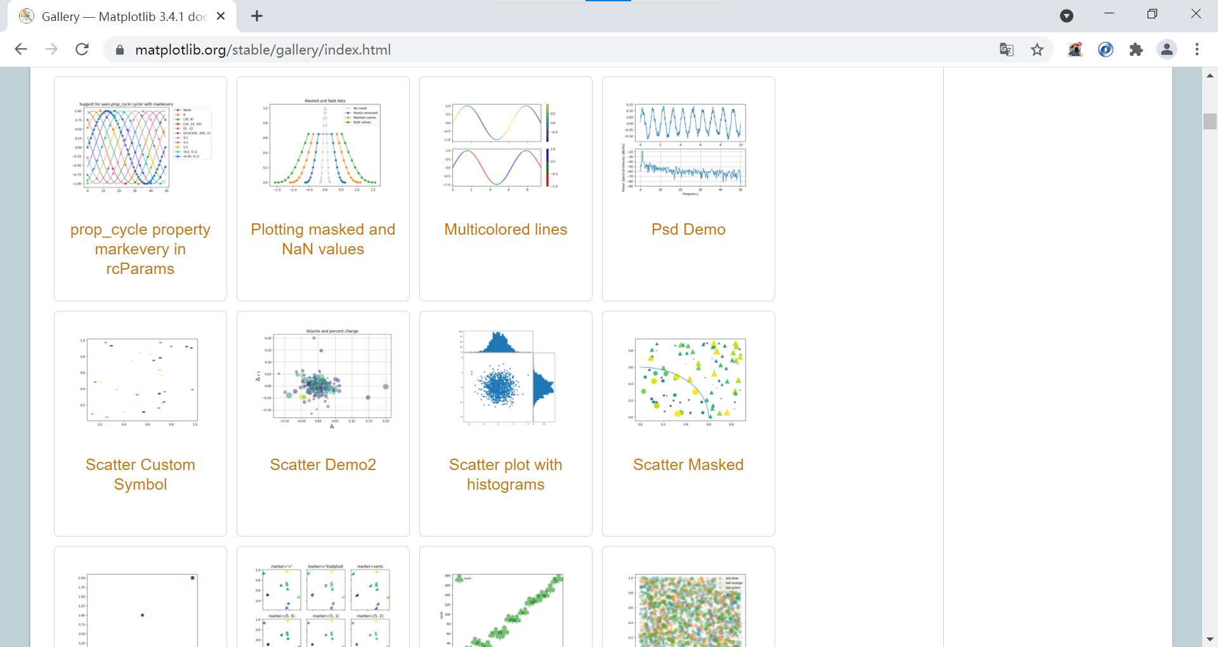

Slide 8
安装
在命令提示符下输入
pip install matplotlib
也可以选择国内镜像安装
pip install matplotlib -i https://pypi.douban.com/simple
pip3 install -i https://pypi.doubanio.com/simple/ matplotlib
部分国内镜像
豆瓣：http://pypi.douban.com/simple/
清华：https://pypi.tuna.tsinghua.edu.cn/simple
阿里云：https://mirrors.aliyun.com/pypi/simple/
中国科技大学 https://pypi.mirrors.ustc.edu.cn/simple/
山东理工大学：https://pypi.sdutlinux.org/

Slide 9
matplotlib.pyplot是matplotlib中最常用的子库之一，它主要用来绘制二维的数据图。

Slide 10
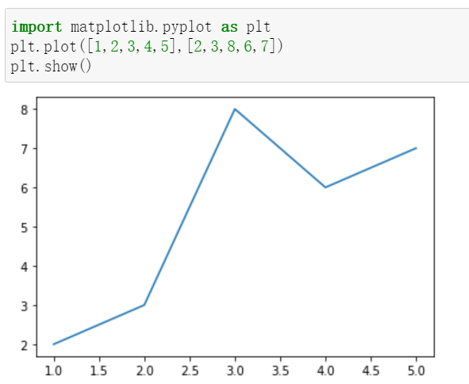
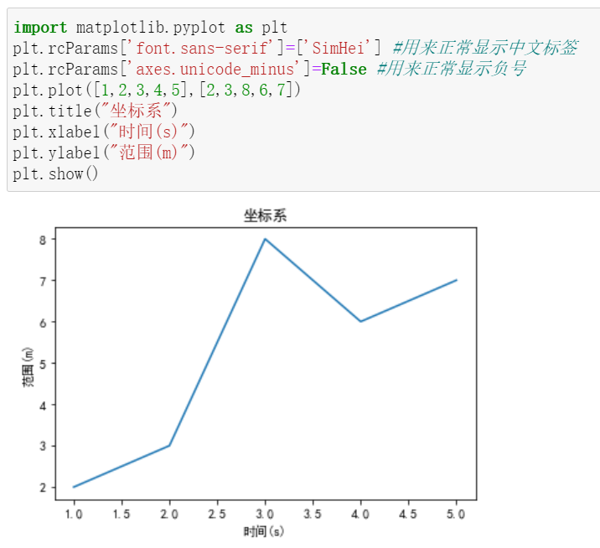
绘制最简单的折线图
title
ylabel
xlabel
Notes:
import matplotlib.pyplot as plt
plt.rcParams['font.sans-serif']=['SimHei'] #用来正常显示中文标签
plt.rcParams['axes.unicode_minus']=False #用来正常显示负号
plt.plot([1,2,3,4,5],[2,3,8,6,7])
plt.title("坐标系")
plt.xlabel("时间(s)")
plt.ylabel("范围(m)")
plt.show()

Slide 11
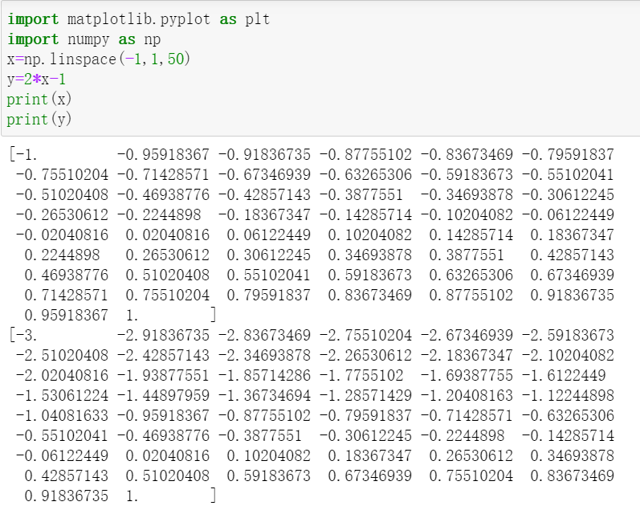
np.linspace()
Notes:
import matplotlib.pyplot as plt
import numpy as np
x=np.linspace(-1,1,50)
y=2*x-1
print(x)
print(y)

Slide 12
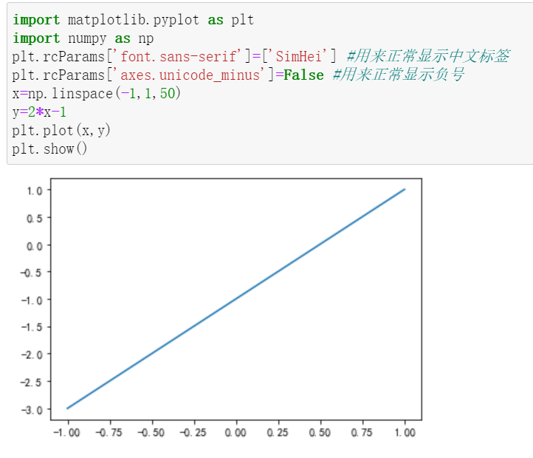
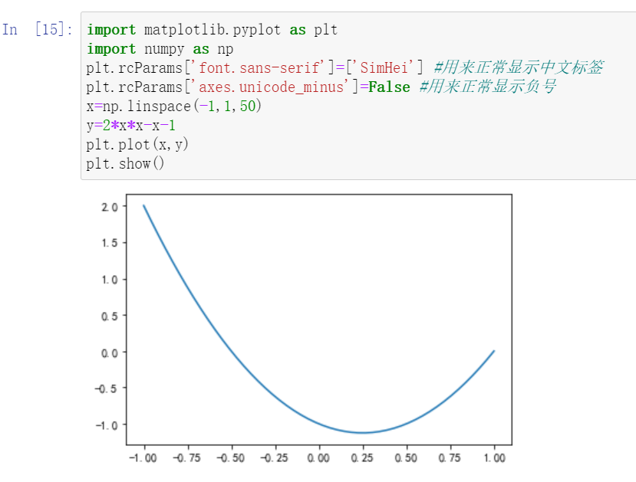
一次函数和二次函数
Notes:
import matplotlib.pyplot as plt
import numpy as np
plt.rcParams['font.sans-serif']=['SimHei'] #用来正常显示中文标签
plt.rcParams['axes.unicode_minus']=False #用来正常显示负号
x=np.linspace(-1,1,50)
y=2*x*x-x-1
plt.plot(x,y)
plt.show()

Slide 13
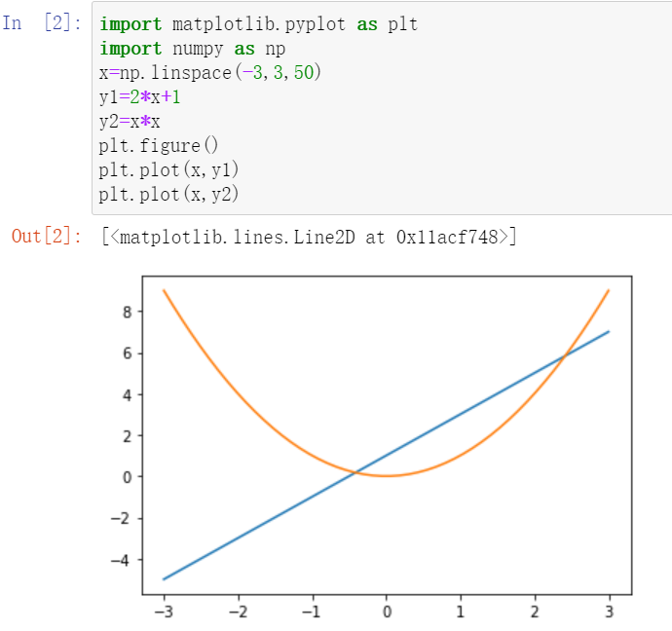
多函数的画法
Notes:
import matplotlib.pyplot as plt
import numpy as np
x=np.linspace(-3,3,50)
y1=2*x+1
y2=x*x
plt.figure()
plt.plot(x,y1)
plt.plot(x,y2)
plt.show()

Slide 14
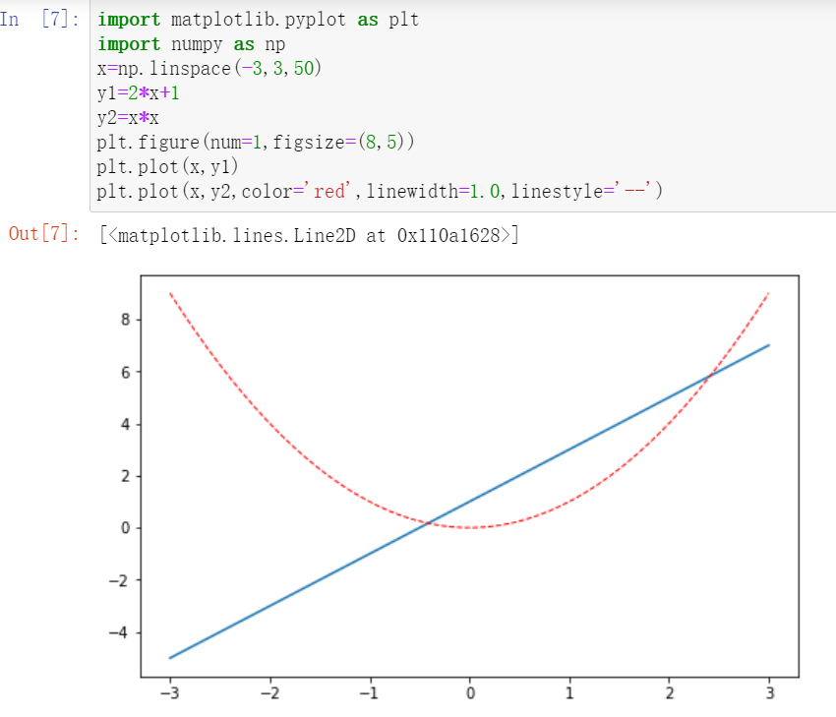
字符 | 线形
- | 实线
-- | 虚线
-. | 点划线
: | 点线
Notes:
import matplotlib.pyplot as plt
import numpy as np
x=np.linspace(-3,3,50)
y1=2*x+1
y2=x*x
plt.figure(num=1,figsize=(8,5))
plt.plot(x,y1)
plt.plot(x,y2,color='red',linewidth=1.0,linestyle=':’,linestyle=‘--’)
plt.show()

Slide 15
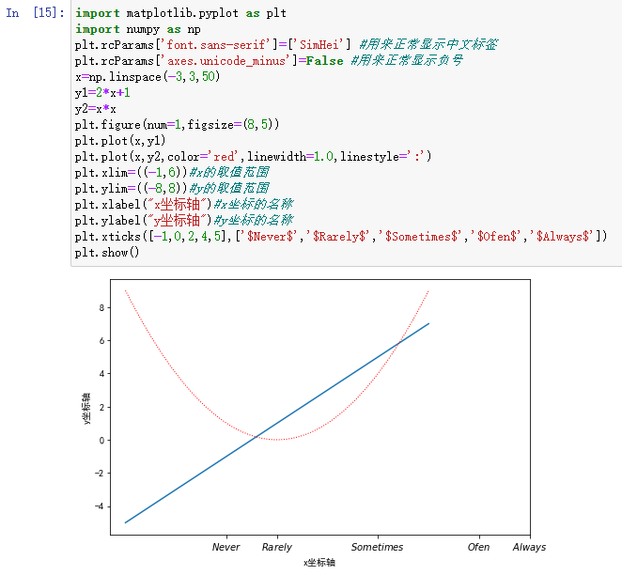
Notes:
import matplotlib.pyplot as plt
import numpy as np
plt.rcParams['font.sans-serif']=['SimHei'] #用来正常显示中文标签
plt.rcParams['axes.unicode_minus']=False #用来正常显示负号
x=np.linspace(-3,3,50)
y1=2*x+1
y2=x*x
plt.figure(num=1,figsize=(8,5))
plt.plot(x,y1)
plt.plot(x,y2,color='red',linewidth=1.0,linestyle=':')
plt.xlim=((-1,6))#x的取值范围
plt.ylim=((-8,8))#y的取值范围
plt.xlabel("x坐标轴")#x坐标的名称
plt.ylabel("y坐标轴")#y坐标的名称
plt.xticks([-1,0,2,4,5],['$Never$','$Rarely$','$Sometimes$','$Ofen$','$Always$'])
plt.show()

Slide 16
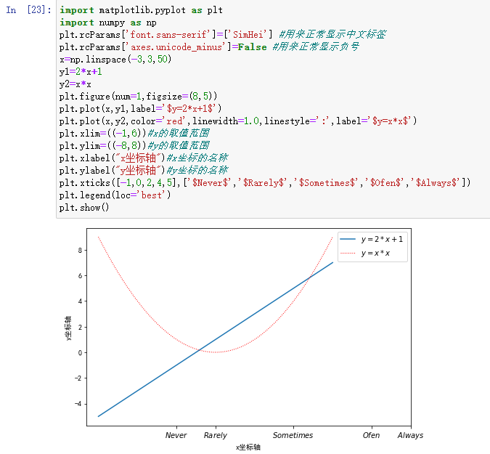
legend()
upper right
upper left
lower left
lower right
right
center left
center right
lower center
upper center
center
Notes:
import matplotlib.pyplot as plt
import numpy as np
plt.rcParams['font.sans-serif']=['SimHei'] #用来正常显示中文标签
plt.rcParams['axes.unicode_minus']=False #用来正常显示负号
x=np.linspace(-3,3,50)
y1=2*x+1
y2=x*x
plt.figure(num=1,figsize=(8,5))
plt.plot(x,y1,label='$y=2*x+1$')
plt.plot(x,y2,color='red',linewidth=1.0,linestyle=':',label='$y=x*x$')
plt.xlim=((-1,6))#x的取值范围
plt.ylim=((-8,8))#y的取值范围
plt.xlabel("x坐标轴")#x坐标的名称
plt.ylabel("y坐标轴")#y坐标的名称
plt.xticks([-1,0,2,4,5],['$Never$','$Rarely$','$Sometimes$','$Ofen$','$Always$'])
plt.legend(loc='best')
plt.show()

Slide 17
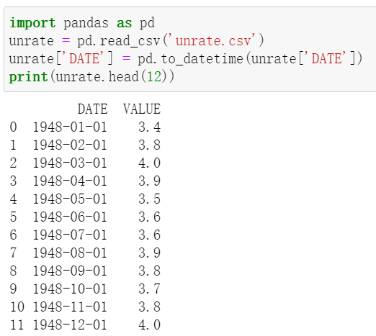
来自于csv文件的数据
Notes:
import pandas as pd
unrate = pd.read_csv('unrate.csv')
unrate['DATE'] = pd.to_datetime(unrate['DATE'])
print(unrate.head(12))

Slide 18
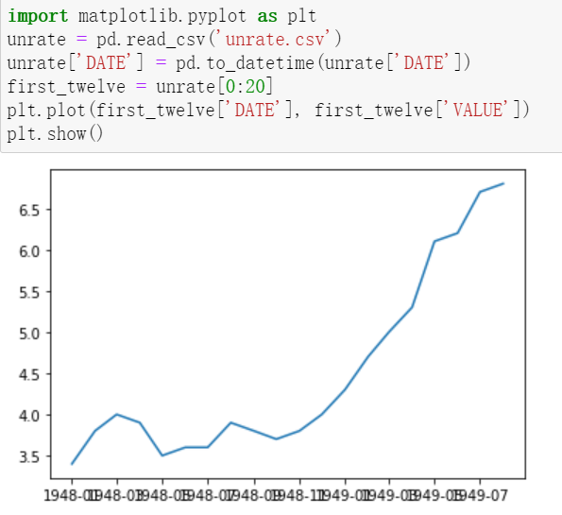
Notes:
import pandas as pd
import matplotlib.pyplot as plt
unrate = pd.read_csv('unrate.csv')
unrate['DATE'] = pd.to_datetime(unrate['DATE'])
first_twelve = unrate[0:20]
plt.plot(first_twelve['DATE'], first_twelve['VALUE'])
plt.show()

Slide 19
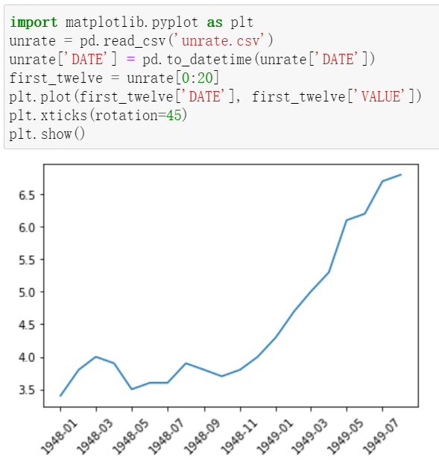
Notes:
import matplotlib.pyplot as plt
unrate = pd.read_csv('unrate.csv')
unrate['DATE'] = pd.to_datetime(unrate['DATE'])
first_twelve = unrate[0:20]
plt.plot(first_twelve['DATE'], first_twelve['VALUE'])
plt.xticks(rotation=45)
plt.show()

Slide 20
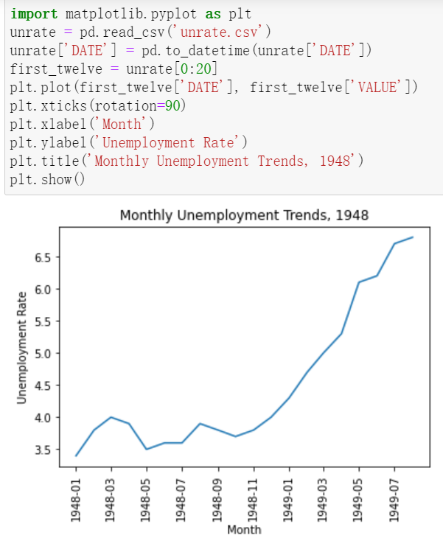
Notes:
import matplotlib.pyplot as plt
unrate = pd.read_csv('unrate.csv')
unrate['DATE'] = pd.to_datetime(unrate['DATE'])
first_twelve = unrate[0:20]
plt.plot(first_twelve['DATE'], first_twelve['VALUE'])
plt.xticks(rotation=90)
plt.xlabel('Month')
plt.ylabel('Unemployment Rate')
plt.title('Monthly Unemployment Trends, 1948')
plt.show()

Slide 21
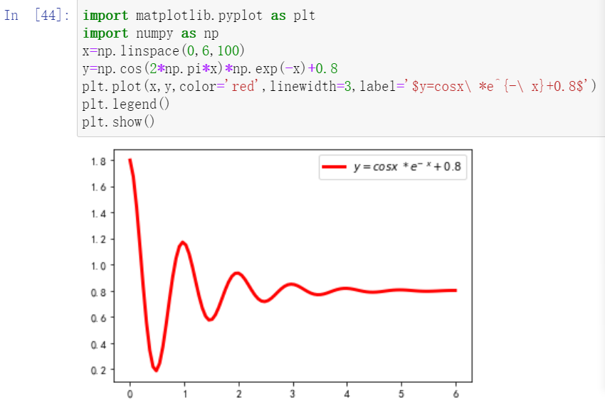
P250例9.1
Notes:
import matplotlib.pyplot as plt
import numpy as np
x=np.linspace(0,6,100)
y=np.cos(2*np.pi*x)*np.exp(-x)+0.8
plt.plot(x,y,color='red',linewidth=3,label='$y=cosx\ *e^{-\ x}+0.8$')
plt.legend()
plt.show()

Slide 22
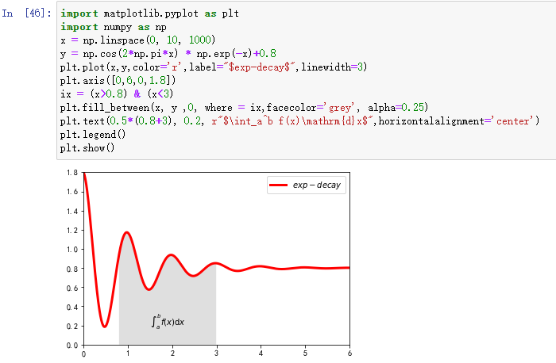
P253 例9.3
Notes:
import matplotlib.pyplot as plt
import numpy as np
x = np.linspace(0, 10, 1000)
y = np.cos(2*np.pi*x) * np.exp(-x)+0.8
plt.plot(x,y,color='r',label="$exp-decay$",linewidth=3)
plt.axis([0,6,0,1.8])
ix = (x>0.8) & (x<3)
plt.fill_between(x, y ,0, where = ix,facecolor='grey', alpha=0.25)
plt.text(0.5*(0.8+3), 0.2, r"$\int_a^b f(x)\mathrm{d}x$",horizontalalignment='center')
plt.legend()
plt.show()

Slide 23
P254 例18

Slide 24
完整代码
import numpy as np
import matplotlib.pyplot as plt
import matplotlib
matplotlib.rcParams['font.family']='SimHei'
matplotlib.rcParams['font.sans-serif'] = ['SimHei']
def Draw(pcolor, nt_point, nt_text, nt_size):
plt.plot(x, y, 'k', label="$exp_decay$", color=pcolor, linewidth=3, linestyle="-")
plt.plot(x, z, "b--", label="$cos(x^2)$", linewidth=1)
plt.xlabel('时间(s)')
plt.ylabel('幅度(mV)')
plt.title("阻尼衰减曲线绘制")
plt.annotate('$\cos(2 \pi t) \exp(-t)$', xy=nt_point, xytext=nt_text, fontsize=nt_size,\
arrowprops=dict(arrowstyle='->', connectionstyle="arc3,rad=.1"))
def Shadow(a, b):
ix = (x>a) & (x<b)
plt.fill_between(x,y,0,where=ix,facecolor='grey', alpha=0.25)
plt.text(0.5 * (a + b), 0.2, "$\int_a^b f(x)\mathrm{d}x$", \
horizontalalignment='center')
def XY_Axis(x_start, x_end, y_start, y_end):
plt.xlim(x_start, x_end)
plt.ylim(y_start, y_end)
plt.xticks([np.pi/3, 2 * np.pi/3, 1 * np.pi, 4 * np.pi/3, 5 * np.pi/3], \
['$\pi/3$', '$2\pi/3$', '$\pi$', '$4\pi/3$', '$5\pi/3$'])
x = np.linspace(0.0, 6.0, 100)
y = np.cos(2 * np.pi * x) * np.exp(-x)+0.8
z = 0.5 * np.cos(x ** 2)+0.8
note_point,note_text,note_size = (1, np.cos(2 * np.pi) * np.exp(-1)+0.8),(1, 1.4), 14
fig = plt.figure(figsize=(8, 6), facecolor="white")
plt.subplot(111)
Draw("red", note_point, note_text, note_size)
XY_Axis(0, 5, 0, 1.8)
Shadow(0.8, 3)
plt.legend()
plt.savefig('sample.JPG')
plt.show()

Slide 25
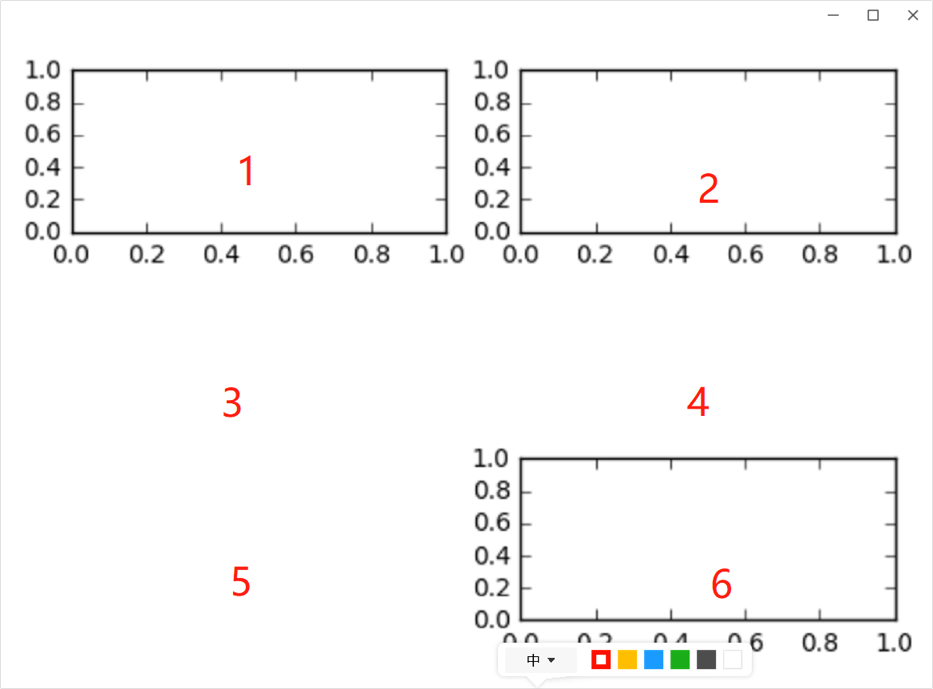
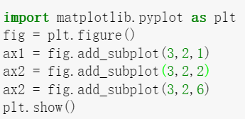
子图的画法
Notes:
import matplotlib.pyplot as plt
fig = plt.figure()
ax1 = fig.add_subplot(3,2,1)
ax2 = fig.add_subplot(3,2,2)
ax3 = fig.add_subplot(3,2,6)
plt.show()

Slide 26
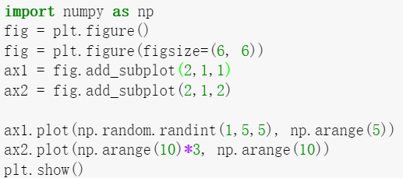
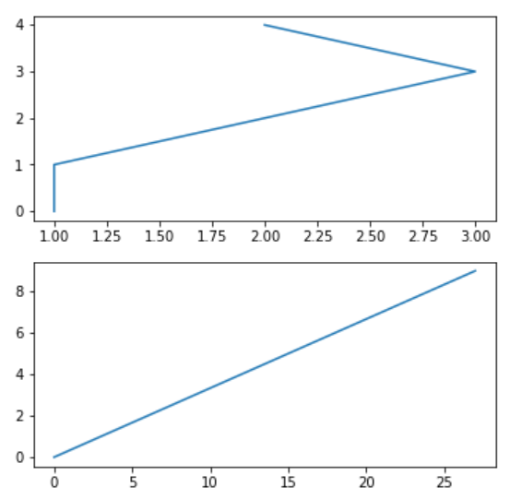
图的尺寸
请大家尝试把ppt16页的两个函数的图画在这里面？
Notes:
import numpy as np
import matplotlib.pyplot as plt
fig = plt.figure()
fig = plt.figure(figsize=(6, 6))
ax1 = fig.add_subplot(2,1,1)
ax2 = fig.add_subplot(2,1,2)
ax1.plot(np.random.randint(1,5,5), np.arange(5))
ax2.plot(np.arange(10)*3, np.arange(10))
plt.show()

Slide 27
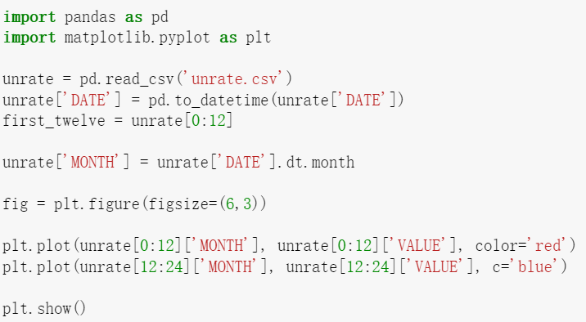
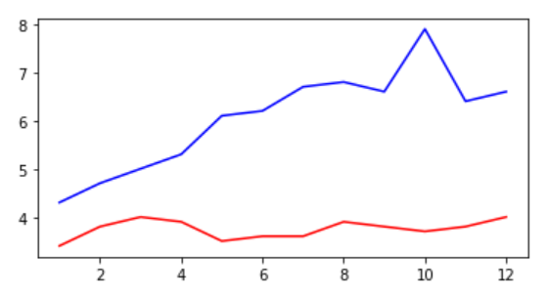
取出时间中的月份
如果想取年份或者日期
或者周几
Notes:
import pandas as pd
import matplotlib.pyplot as plt
unrate = pd.read_csv('unrate.csv')
unrate['DATE'] = pd.to_datetime(unrate['DATE'])
first_twelve = unrate[0:12]
unrate['MONTH'] = unrate['DATE'].dt.month
fig = plt.figure(figsize=(6,3))
plt.plot(unrate[0:12]['MONTH'], unrate[0:12]['VALUE'], color='red')
plt.plot(unrate[12:24]['MONTH'], unrate[12:24]['VALUE'], c='blue')
plt.show()

Slide 28
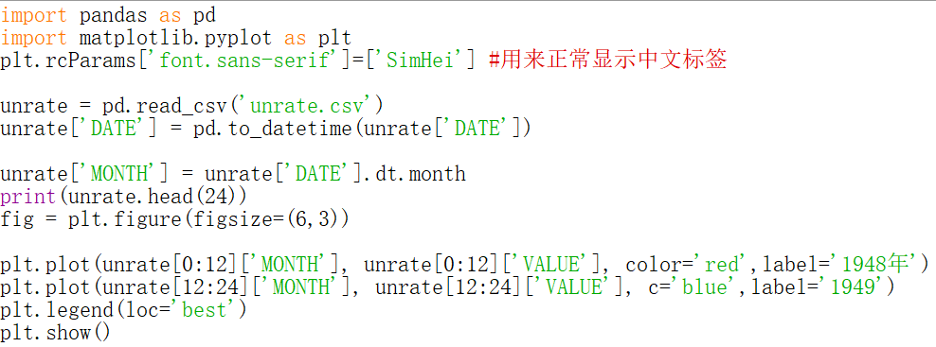
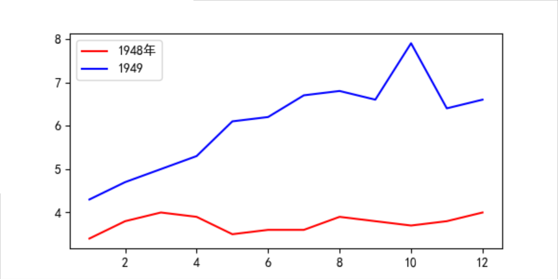
请给此图加上legend
数轴的label
title
Notes:
import pandas as pd
import matplotlib.pyplot as plt
plt.rcParams['font.sans-serif']=['SimHei'] #用来正常显示中文标签
unrate = pd.read_csv('unrate.csv')
unrate['DATE'] = pd.to_datetime(unrate['DATE'])
unrate['MONTH'] = unrate['DATE'].dt.month
print(unrate.head(24))
fig = plt.figure(figsize=(6,3))
plt.plot(unrate[0:12]['MONTH'], unrate[0:12]['VALUE'], color='red',label='1948年')
plt.plot(unrate[12:24]['MONTH'], unrate[12:24]['VALUE'], c='blue',label='1949')
plt.legend(loc='best')
#plt.xlabel('')
#plt.ylabel('')
#plt.title('')
plt.show()

Slide 29
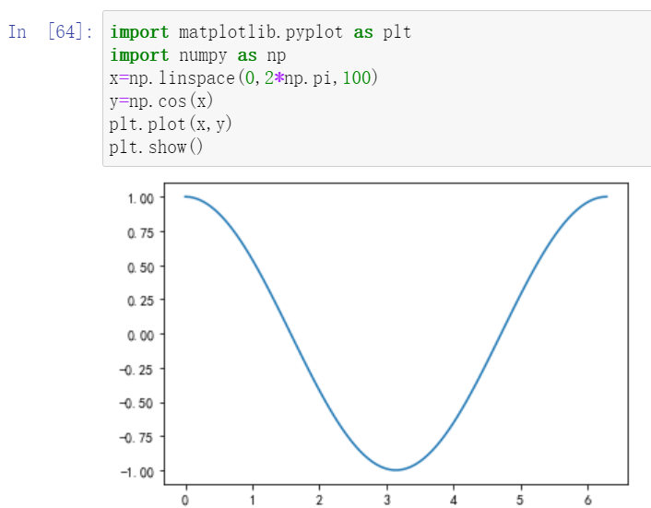
运动的余弦函数
Notes:
import matplotlib.pyplot as plt import numpy as np from matplotlib import animation fig,ax=plt.subplots() x=np.linspace(0,2*np.pi,100) line,=ax.plot(x,np.cos(x)) def animate(i): line.set_ydata(np.cos(x+i/10)) return line, def init(): line.set_ydata(np.cos(x)) return line, ani=animation.FuncAnimation(fig=fig,func=animate,frames=100,init_func=init,interval=20,blit=False) plt.show()

Slide 30
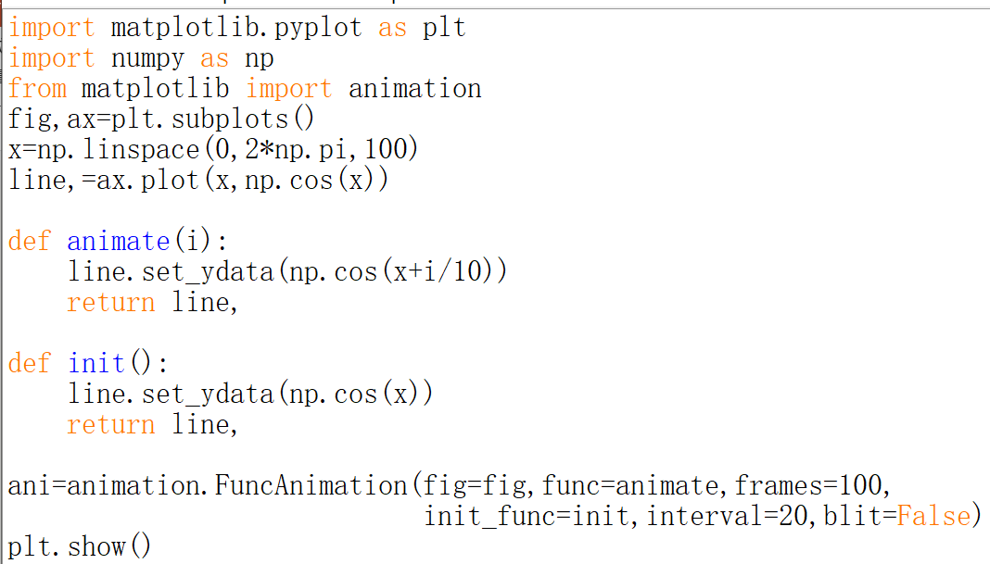
Notes:
import numpy as np
from matplotlib import pyplot as plt
from matplotlib import animation
fig,ax=plt.subplots()
x=np.arange(0,2*np.pi,0.01)
line,=ax.plot(x,np.sin(x))
def init():
line.set_ydata(np.sin(x))
return line,
def animate(i):
line.set_ydata(np.sin(x+i/10))
return line,
ani=animation.FuncAnimation(fig=fig,func=animate,frames=100,init_func=init,interval=20,blit=False)
plt.show()

Slide 31
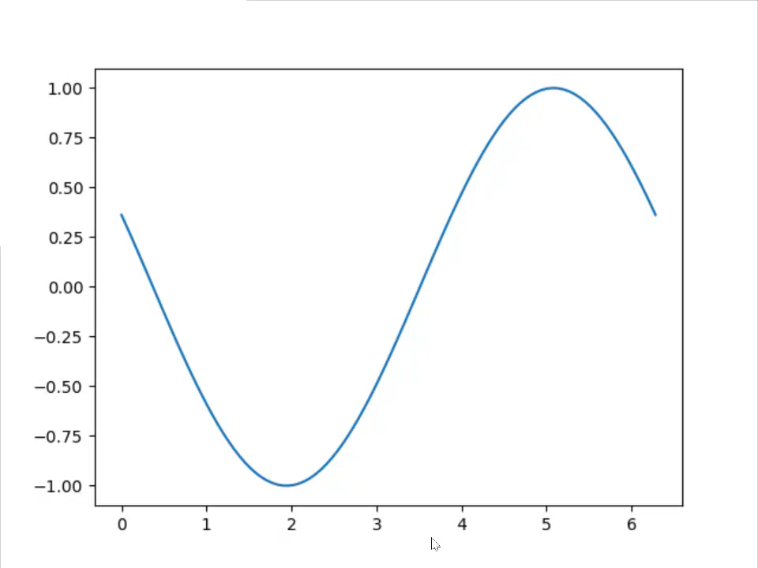

Slide 32
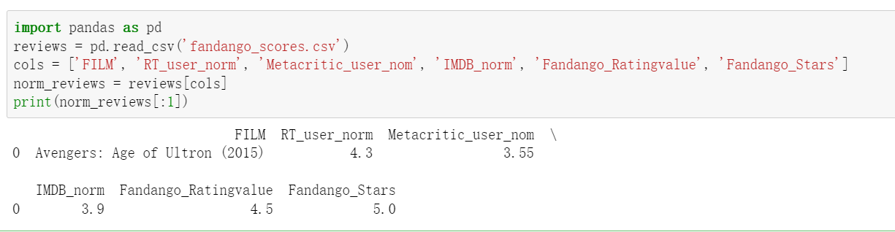
Notes:
import pandas as pd
reviews = pd.read_csv('fandango_scores.csv')
cols = ['FILM', 'RT_user_norm', 'Metacritic_user_nom', 'IMDB_norm', 'Fandango_Ratingvalue', 'Fandango_Stars']
norm_reviews = reviews[cols]
print(norm_reviews[:1])

Slide 33
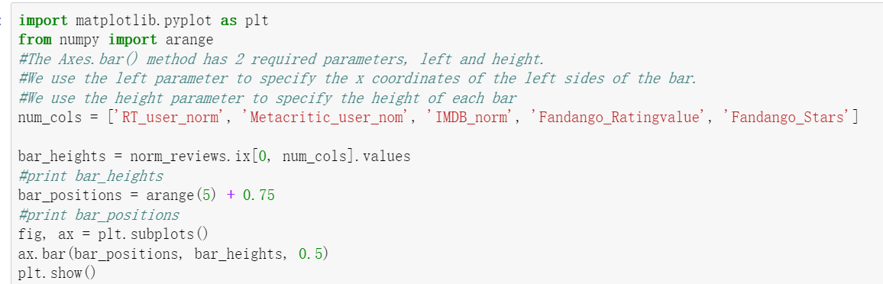
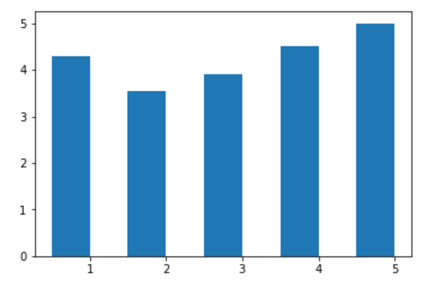
Notes:
import pandas as pd
import matplotlib.pyplot as plt
from numpy import arange
reviews = pd.read_csv('fandango_scores.csv')
cols = ['FILM', 'RT_user_norm', 'Metacritic_user_nom', 'IMDB_norm', 'Fandango_Ratingvalue', 'Fandango_Stars']
norm_reviews = reviews[cols]
num_cols = ['RT_user_norm', 'Metacritic_user_nom', 'IMDB_norm', 'Fandango_Ratingvalue', 'Fandango_Stars']
bar_heights = norm_reviews.ix[0, num_cols].values
#print bar_heights
bar_positions = arange(5) + 0.75
#print bar_positions
fig, ax = plt.subplots()
ax.bar(bar_positions, bar_heights, 0.5)
plt.show()

Slide 34
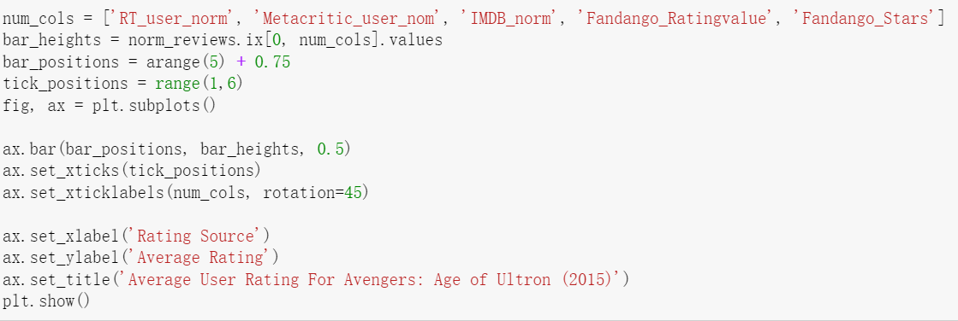
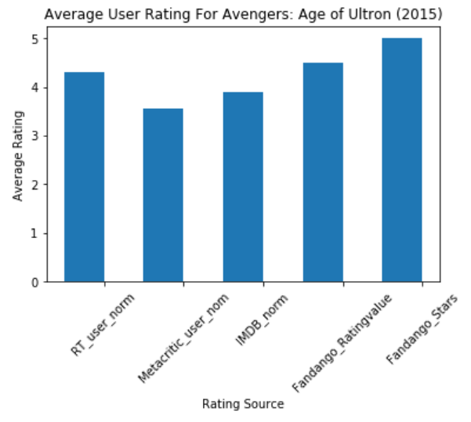
Notes:
import pandas as pd
import matplotlib.pyplot as plt
from numpy import arange
reviews = pd.read_csv('fandango_scores.csv')
cols = ['FILM', 'RT_user_norm', 'Metacritic_user_nom', 'IMDB_norm', 'Fandango_Ratingvalue', 'Fandango_Stars']
norm_reviews = reviews[cols]
num_cols = ['RT_user_norm', 'Metacritic_user_nom', 'IMDB_norm', 'Fandango_Ratingvalue', 'Fandango_Stars']
bar_heights = norm_reviews.ix[0, num_cols].values
bar_positions = arange(5) + 0.75
tick_positions = range(1,6)
fig, ax = plt.subplots()
ax.bar(bar_positions, bar_heights, 0.5)
ax.set_xticks(tick_positions)
ax.set_xticklabels(num_cols, rotation=45)
ax.set_xlabel('Rating Source')
ax.set_ylabel('Average Rating')
ax.set_title('Average User Rating For Avengers: Age of Ultron (2015)')
plt.show()

Slide 35
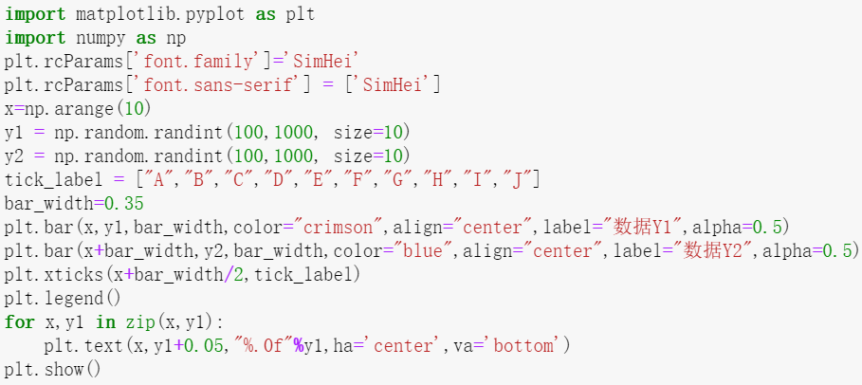
柱状体
Notes:
import matplotlib as mpl
import matplotlib.pyplot as plt
import numpy as np
matplotlib.rcParams['font.family']='SimHei'
matplotlib.rcParams['font.sans-serif'] = ['SimHei']
x=np.arange(10)
y1 = np.random.randint(100,1000, size=10)
y2 = np.random.randint(100,1000, size=10)
tick_label = ["A","B","C","D","E","F","G","H","I","J"]
bar_width=0.35
plt.bar(x,y1,bar_width,color="c",align="center",label="数据Y1",alpha=0.5)
plt.bar(x+bar_width,y2,bar_width,color="b",align="center",label="数据Y2",alpha=0.5)
plt.xticks(x+bar_width/2,tick_label)
plt.legend()
for x,y1 in zip(x,y1):
plt.text(x,y1+0.05,"%.0f"%y1,ha='center',va='bottom')
plt.show()

Slide 36
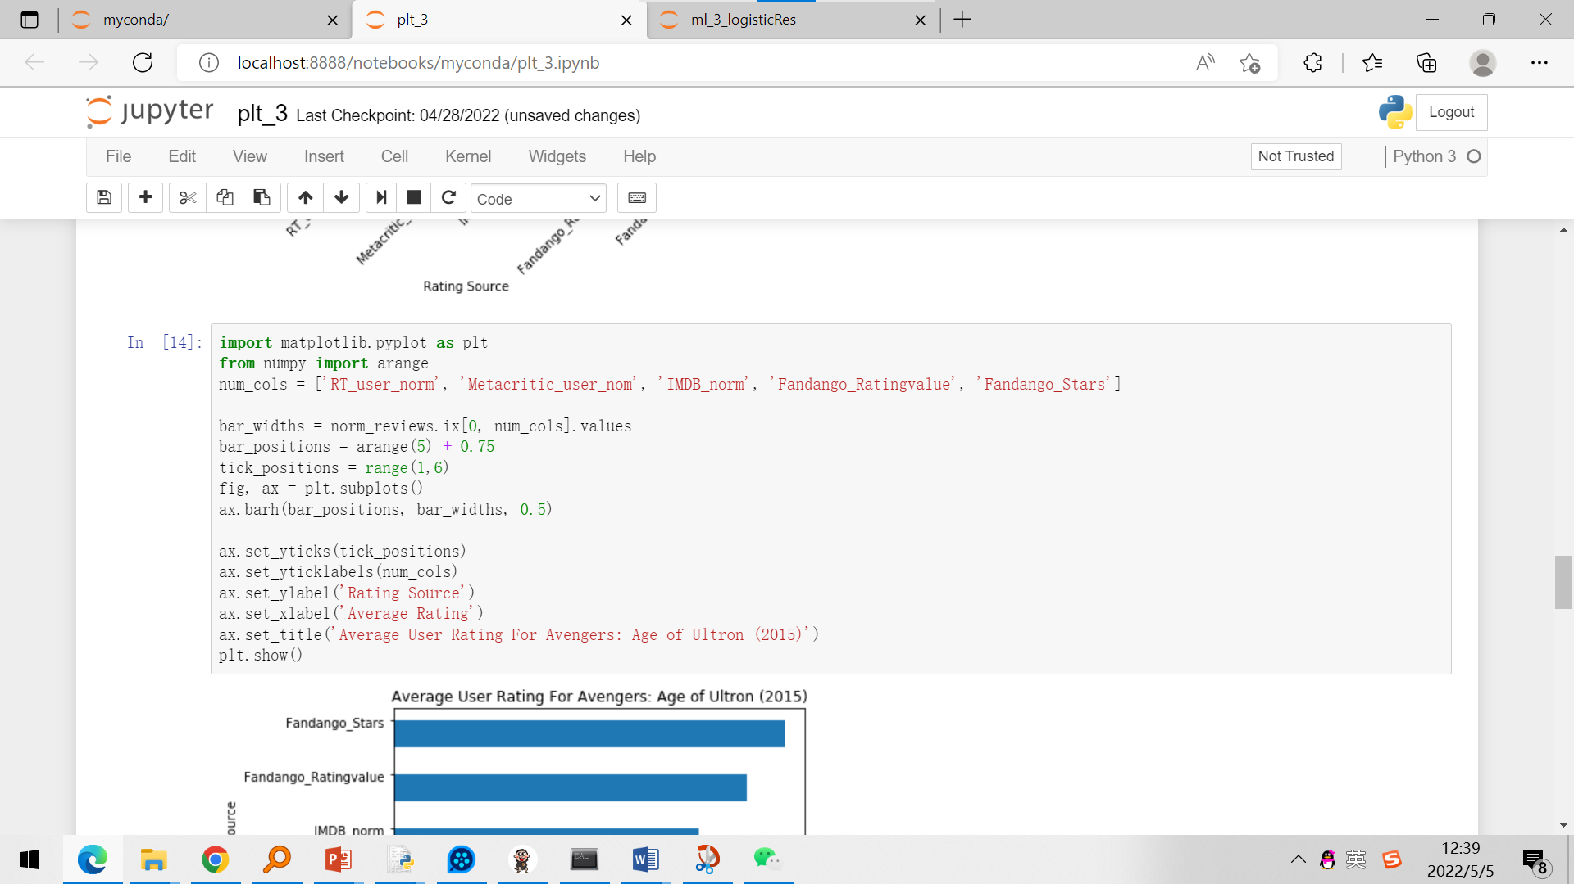
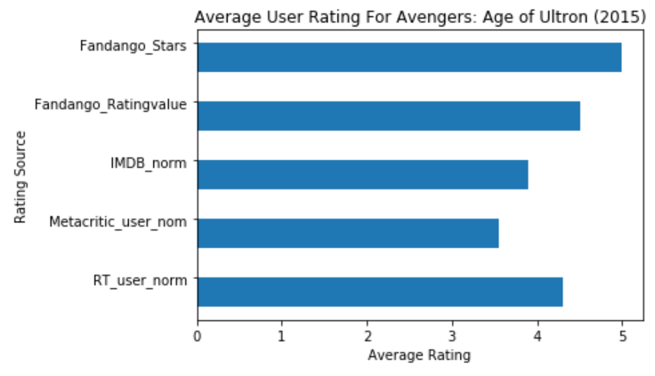
Notes:
import matplotlib.pyplot as plt
from numpy import arange
num_cols = ['RT_user_norm', 'Metacritic_user_nom', 'IMDB_norm', 'Fandango_Ratingvalue', 'Fandango_Stars']
bar_widths = norm_reviews.ix[0, num_cols].values
bar_positions = arange(5) + 0.75
tick_positions = range(1,6)
fig, ax = plt.subplots()
ax.barh(bar_positions, bar_widths, 0.5)
ax.set_yticks(tick_positions)
ax.set_yticklabels(num_cols)
ax.set_ylabel('Rating Source')
ax.set_xlabel('Average Rating')
ax.set_title('Average User Rating For Avengers: Age of Ultron (2015)')
plt.show()

Slide 37
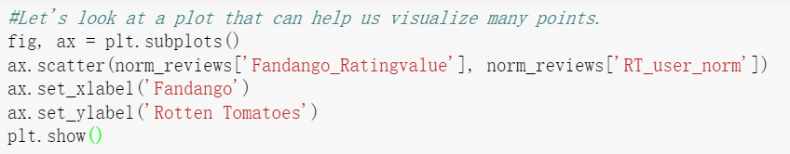
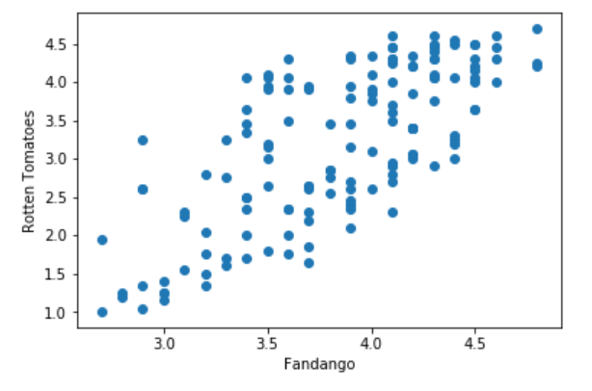
Notes:
#Let's look at a plot that can help us visualize many points.
fig, ax = plt.subplots()
ax.scatter(norm_reviews['Fandango_Ratingvalue'], norm_reviews['RT_user_norm'])
ax.set_xlabel('Fandango')
ax.set_ylabel('Rotten Tomatoes')
plt.show()

Slide 38
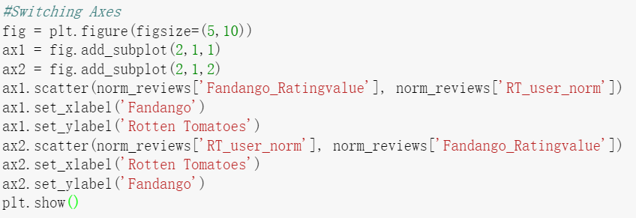
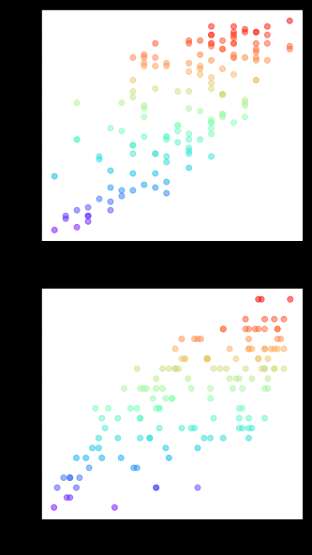
Notes:
#Switching Axes
fig = plt.figure(figsize=(5,10))
ax1 = fig.add_subplot(2,1,1)
ax2 = fig.add_subplot(2,1,2)
ax1.scatter(norm_reviews['Fandango_Ratingvalue'], norm_reviews['RT_user_norm'],c=norm_reviews['RT_user_norm'],alpha=0.5,cmap='rainbow')
ax1.set_xlabel('Fandango')
ax1.set_ylabel('Rotten Tomatoes')
ax2.scatter(norm_reviews['RT_user_norm'], norm_reviews['Fandango_Ratingvalue'],c=norm_reviews['Fandango_Ratingvalue'],alpha=0.5,cmap='rainbow')
ax2.set_xlabel('Rotten Tomatoes')
ax2.set_ylabel('Fandango')
plt.show()

Slide 39
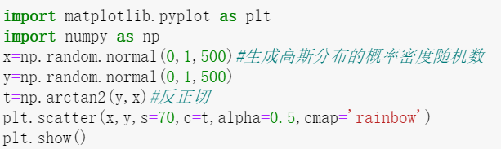
散点图
给PPT37加点颜色吧
Notes:
import matplotlib.pyplot as plt
import numpy as np
x=np.random.normal(0,1,500)#生成高斯分布的概率密度随机数
y=np.random.normal(0,1,500)
t=np.arctan2(y,x)#反正切
plt.scatter(x,y,s=70,c=t,alpha=0.5,cmap=‘rainbow’)
plt.show()

Slide 40
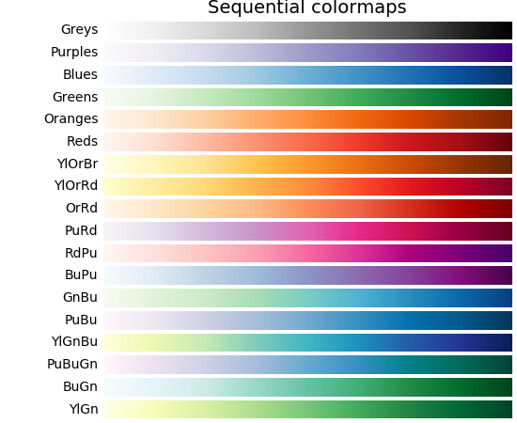
cmap
https://matplotlib.org/2.0.2/users/colormaps.html

Slide 41
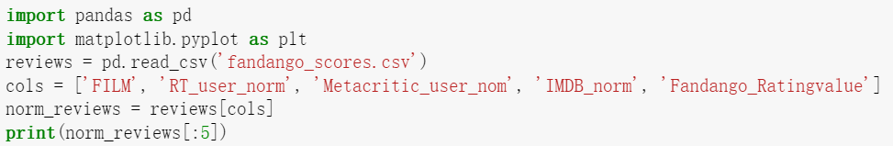
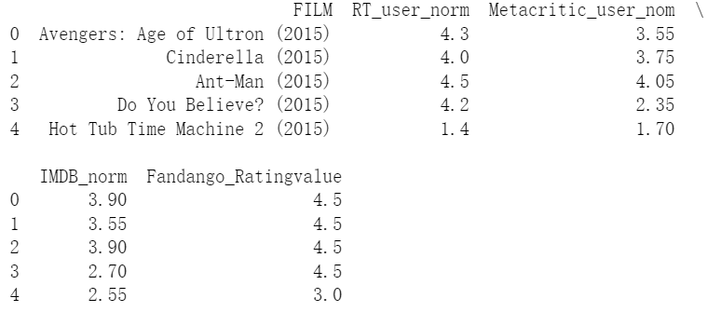
Notes:
import pandas as pd
import matplotlib.pyplot as plt
reviews = pd.read_csv('fandango_scores.csv')
cols = ['FILM', 'RT_user_norm', 'Metacritic_user_nom', 'IMDB_norm', 'Fandango_Ratingvalue']
norm_reviews = reviews[cols]
print(norm_reviews[:5])

Slide 42
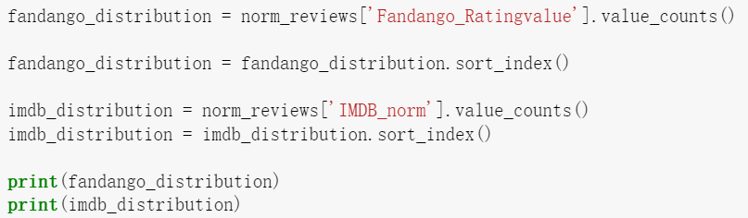
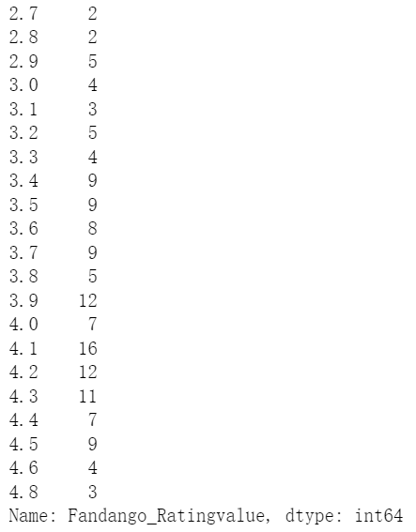
分类统计
Notes:
fandango_distribution = norm_reviews['Fandango_Ratingvalue'].value_counts()
fandango_distribution = fandango_distribution.sort_index()
imdb_distribution = norm_reviews['IMDB_norm'].value_counts()
imdb_distribution = imdb_distribution.sort_index()
print(fandango_distribution)
print(imdb_distribution)

Slide 43
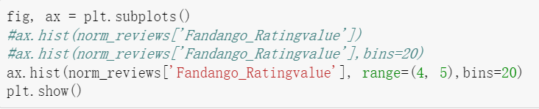

Notes:
fig, ax = plt.subplots()
#ax.hist(norm_reviews['Fandango_Ratingvalue'])
#ax.hist(norm_reviews['Fandango_Ratingvalue'],bins=20)
ax.hist(norm_reviews['Fandango_Ratingvalue'], range=(4, 5),bins=20)
plt.show()

Slide 44

Notes:
fig = plt.figure(figsize=(8,8))
ax1 = fig.add_subplot(2,2,1)
ax2 = fig.add_subplot(2,2,2)
ax3 = fig.add_subplot(2,2,3)
ax4 = fig.add_subplot(2,2,4)
ax1.hist(norm_reviews['Fandango_Ratingvalue'], bins=20, range=(0, 5))
ax1.set_title('Distribution of Fandango Ratings')
ax1.set_ylim(0, 50)
ax2.hist(norm_reviews['RT_user_norm'], 20, range=(0, 5))
ax2.set_title('Distribution of Rotten Tomatoes Ratings')
ax2.set_ylim(0, 50)
ax3.hist(norm_reviews['Metacritic_user_nom'], 20, range=(0, 5))
ax3.set_title('Distribution of Metacritic Ratings')
ax3.set_ylim(0, 50)
ax4.hist(norm_reviews['IMDB_norm'], 20, range=(0, 5))
ax4.set_title('Distribution of IMDB Ratings')
ax4.set_ylim(0, 50)
plt.show()

Slide 45


Slide 46


箱图
密度图
Notes:
fig, ax = plt.subplots()
ax.boxplot(norm_reviews['RT_user_norm'])
ax.set_xticklabels(['Rotten Tomatoes'])
ax.set_ylim(0, 5)
plt.show()

Slide 47

最高值
上四分位数
中位数
下四分位数
最低值
异常值

Slide 48


箱图
Notes:
num_cols = ['RT_user_norm', 'Metacritic_user_nom', 'IMDB_norm', 'Fandango_Ratingvalue']
fig, ax = plt.subplots()
ax.boxplot(norm_reviews[num_cols].values)
ax.set_xticklabels(num_cols, rotation=90)
ax.set_ylim(0,5)
plt.show()

Slide 49


Notes:
import matplotlib.pyplot as plt
import numpy as np
from mpl_toolkits.mplot3d import Axes3D
plt.rcParams['axes.unicode_minus'] =False
fig=plt.figure()
ax=Axes3D(fig)
x=np.arange(-4,4,0.25)
y=np.arange(-4,4,0.25)
x,y=np.meshgrid(x,y)
z=x*x+y*y
ax.plot_surface(x,y,z,rstride=1,cstride=1,cmap="PuBu")

Slide 50
本讲要点
折线图
散点图
matplotlib
柱状图
三维图
动态图

Slide 51

感谢您的关注
Thank You for Your Attention

